Slide 1
Google Collab for AlphaFold2 link:
https://colab.research.google.com/github/sokrypton/ColabFold/blob/main/AlphaFold2.ipynb#scrollTo=mbaIO9pWjaN0
Protein Sequence:
QQGITPNYVGDLNLDDQFKGNVCHAFTLEAIIDISAYNERTVKGVPAWLPLGIMSNFEYPLAHTVAALLTGSYTITQFTHNGQKFVRVNRLGTGIPAHPLRMLREGNQAFIQNMVIPRNFSTNQFTYNLTNLVLSVQKLPDDAWRPSKDKLIGNTMHPAVSIHPNLPPIVLPTVKKQAYR

Slide 2
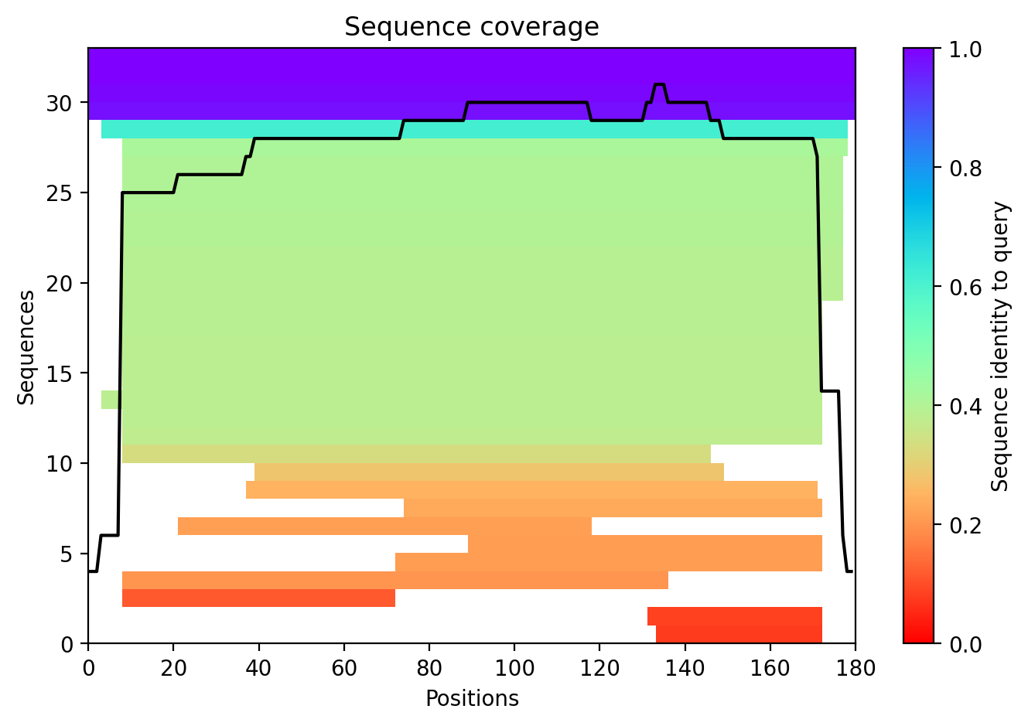

Slide 3
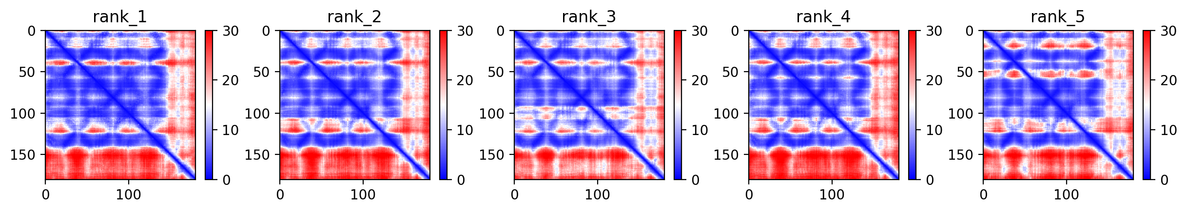

Slide 4
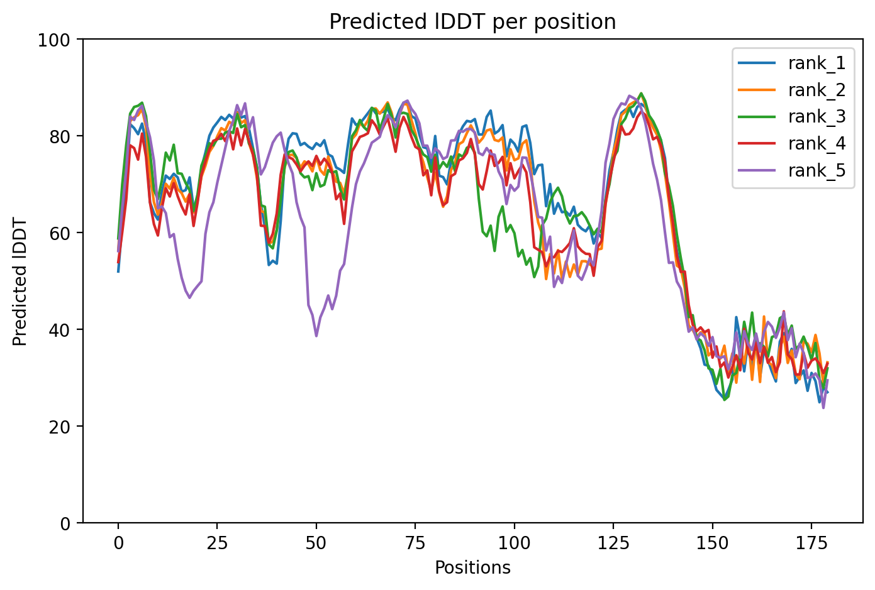

Slide 5
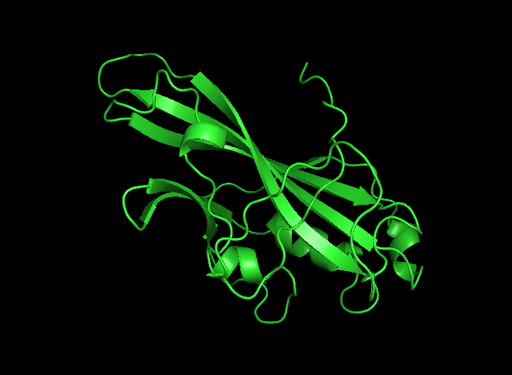

Slide 6
AlphaFold3 https://golgi.sandbox.google.com/

Slide 7
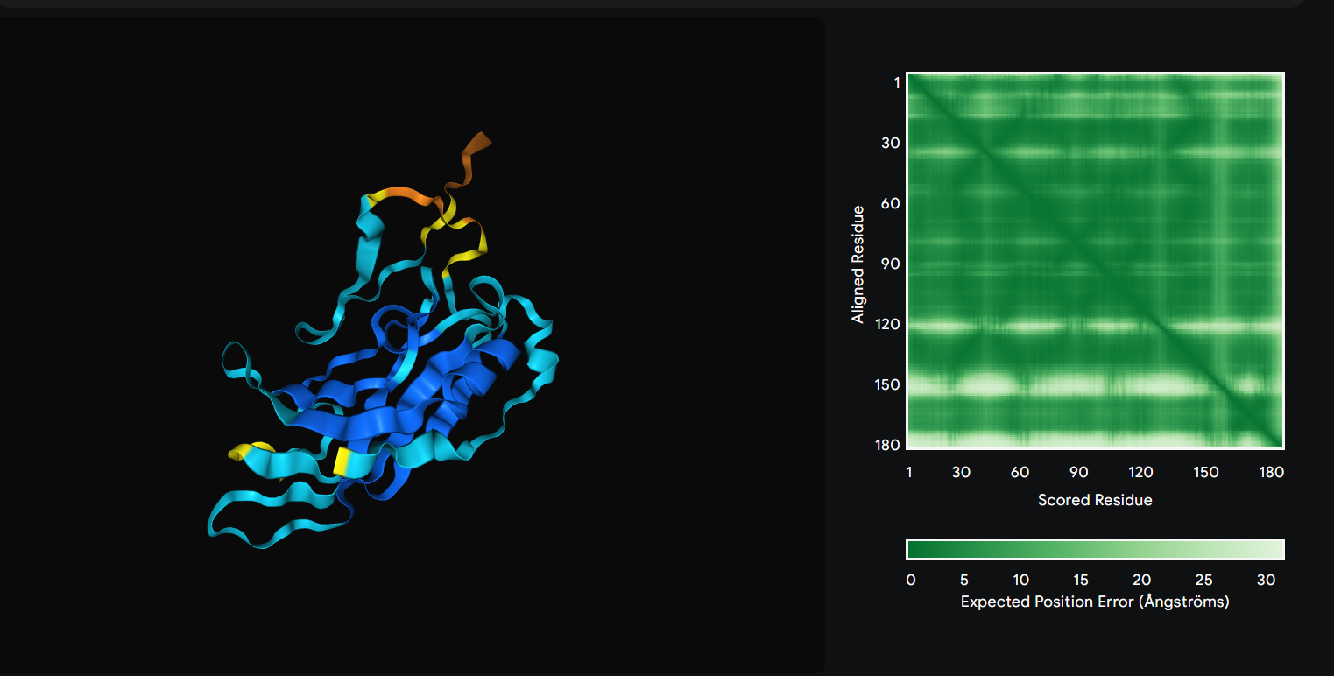

Slide 8
